Slide 1
GBT Project Report
Block-based Parallel Tree Building in GBT
Bo Peng
IPCC@Indiana University

Slide 2
Outline
The problem and basic ideas
Current results
Plan for next step

Slide 3
The Problem
Goal: Build a distributed version of GBT with DAAL GBT kernel and Harp communication library
Problem:
How to optimize parallel tree building in GBT?
bottle neck in BuildHist()

Slide 4
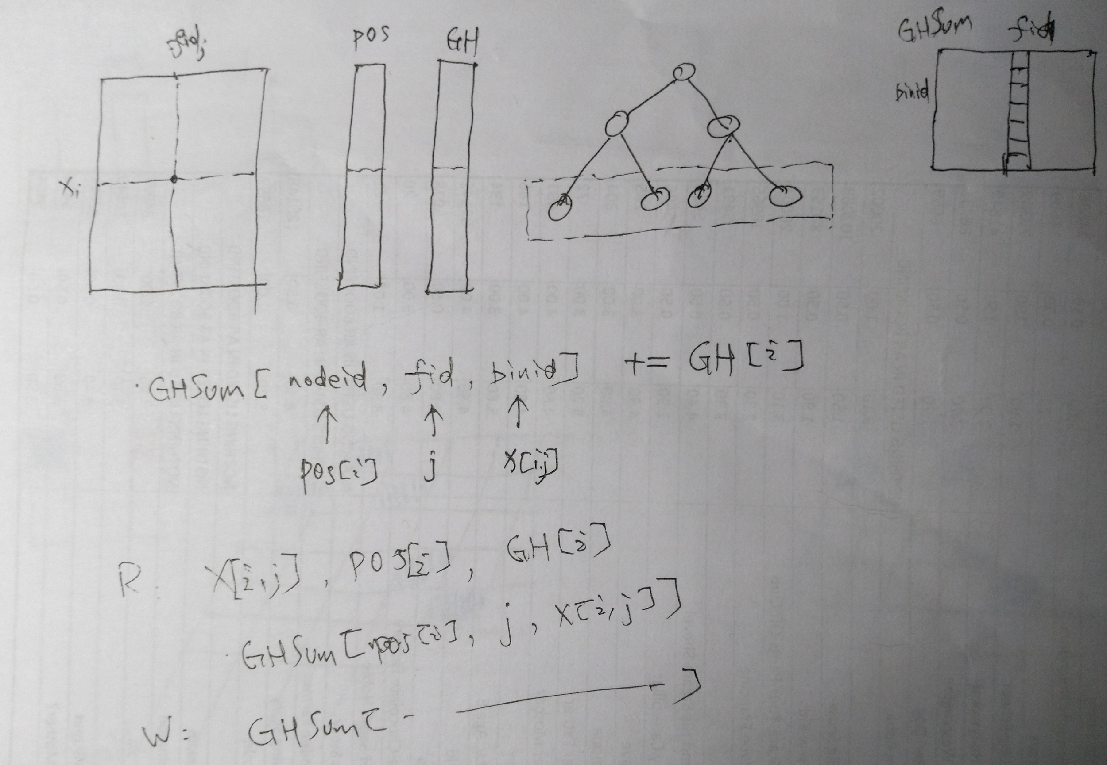

Slide 5
Solution Example: xgb-approx, daalgbt
solution:
(feature)column-wised training data orgnization
model parallelism: feature level parallelism, (support nodeid level)
maintain node rowset (aggregate the same nodeid togather in POS)
read Pos sequentially, random access to training data
write GHSum without conflicts in multithreading
pros : write cache friendly
each thread write to different small regions, inside which <featureid, nodeid> are the same,
binid_size=256, 2K fit into L1
cons : read not cache friendly
read only one feature in one example at most, the others in cache line are wasted due to the random access pattern
read POS/GH reduntantly among threads

Slide 6
Solution Example: xgb-hist
solution:
row-wised training data orgnization
data parallelism: data partition by rowid
maintain node rowset (aggregate the same nodeid togather in POS)
read Pos sequentially, random access to rows of training data
write thread-local GHSum and do all-reduce in the end
pros : read cache friendly
read cache friendly, read POS/GH and data only once
write to thread local memory, easy to introduce more parallelism
cons : write can be a problem
potential write cache miss for dataset with large number of features, write to a region with space of <feature_number × binid_size>
1k features, binid_size=256, region = 2MB, can not fit to L1
copies of the model occupy much more memory, model copies = 2^max_depth * threadNumber
potentially a problem in case of deep tree and large number of threads

Slide 7
Proposed Solution: harpdaal-block
a general or mixture solution:
block-wised training data orgnization
model parallelism: feature level and binid level parallelism
data parallelism: data partitions
do not maintain node rowset
read blocks of training data sequentially, access POS/GH sequentially
write GHSum without conflicts in multithreading
write to thread-local GHSum is an option for row-blocks
block in training data is defined as <row_blk_size, bin_blk_size, feature_blk_size>
no random read access to training data and GH/POS
select the size parameters to control the read redundancy of GH/POS and cache performance
thread write to region in GHSum <Bin_blk_size, Node_size, Feature_blk_size>
different memory layout, BNF by default
select the size parameters to control the write cache performance

Slide 8
Basic Ideas - Compact Data Structure
Use binid instead of fvalue during the tree building
max_bins 256, 1 Byte compact for dense input
release the memory of the source input matrix

Slide 9
Basic Ideas- Parallelism Level
training data:
block := <row_blk_size, bin_blk_size, feature_blk_size>, 0 for all
model data:
GHSum is a 3-D matrix, <binid, nodeid, fid>
all cells can be accessed in parallel without conflicts
scheduler:
blocks with smaller row_block_id first, in order to reuse POS/GH
for row-blocks, currently use spinlock to avoid conflicts
todo: priority contorl and thead-local model copy
Block-based parallelism
block=<0, 256,1> equals to feature-wised solution xgb-approx (except no rowset matained and no random read access)
block=<0, 256,0> equals to row-wised solution xgb-hist, but limited threads number
block=<0, 256,16> keep balance for read/write
block=<0,16,0> similiar to xgb-hist, but support 16 threads write to model without conflicts
...

Slide 10
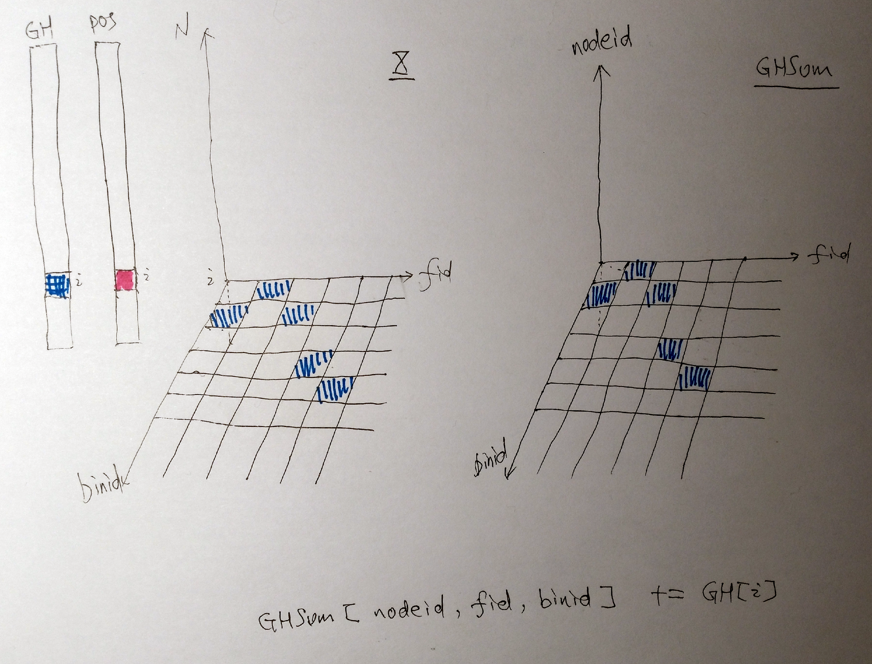
BuildHist

Slide 11
Basic Ideas- Vectorization
BuildHist is not computation intensive
indirect memory access
even scatter/gather vectorization seems to be infeasible here
hard to avoid conflicts in write
computation on GHSum can be vectorized
halftrick: GHSum_right = GHSum_parent - GHSum_left

Slide 12
Evalutation

Slide 13
Configuration
machine
CPU: Intel(R) Xeon(R) CPU E5-2699 v3 @ 2.30GHz
Cores: 2 Sockets x36 cores each = 72 Cores (thread# set to 32)
RAM: 128 GB
Compiler
gcc (crosstool-NG fa8859cb) 7.2.0
icc (ICC) 19.0.0.117 20180804

Slide 14
Dataset
dataset | train# | test# | features# | sparsity | size
synset | 1m |  | 1024 | dense | 22 GB
airline | 1m | 100K | 690 | dense(one-hot encoding) | 2.6 GB/63 MB
higgs | 10m | 1m | 28 | dense | 4.8 GB

Slide 15
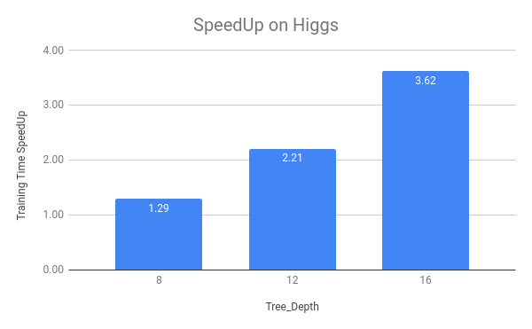
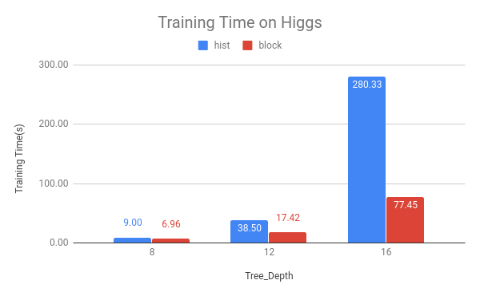
SpeedUp of Training Time
Higgs, eta=0.1, num_round=10, thread=32, block=<0.05,0,1>

Slide 16
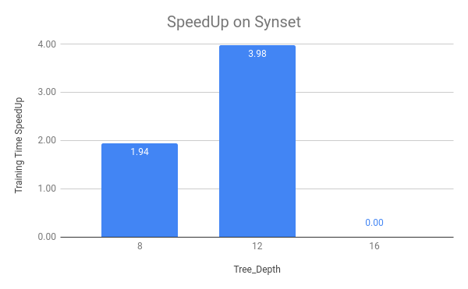
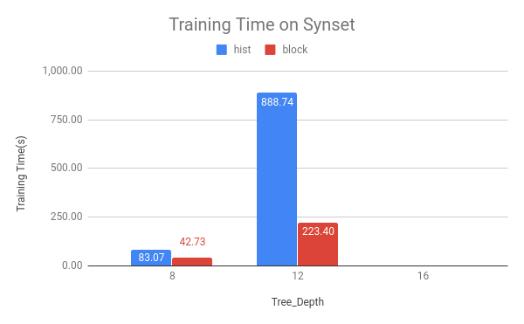
Synset, eta=0.1, num_round=10, thread=32, block=<0.5,0,16>
Out-of-memory for tree_depth=16

Slide 17
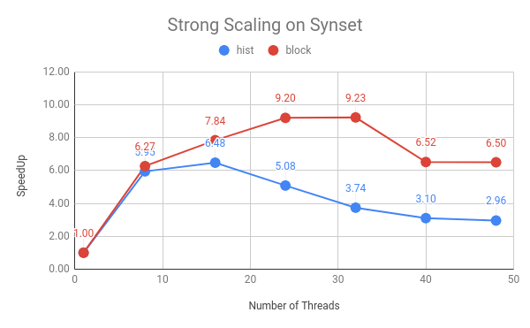
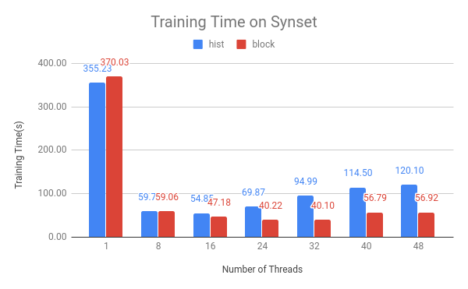
Strong Scaling of Multithreading
Synset, tree_depth=8, num_round=10,block=<0,0,16>

Slide 18
Future Plan
Sampling Algorithm
add approximation to get the statistics of GHSum
similiar to Histogram, using partial examples is possible to get enough accurate GHSum, the sampling algorithm should be important
Distributed version
BlockVersion + Sampling + Harp CollectiveCommunication(rotation)

Slide 19
Q&A

Slide 20
Cost Model
Read
read continuously and reuse if possible
Write
make write operations in constrained small region if possible

Slide 21
Configuration
machine
CPU: Intel(R) Xeon(R) CPU E5-2699 v3 @ 2.30GHz
Cores: 2 Sockets x36 cores each = 72 Cores (thread# set to 32)
RAM: 128 GB
Compiler
gcc (crosstool-NG fa8859cb) 7.2.0
icc (ICC) 19.0.0.117 20180804

Slide 22
Dataset
dataset | train# | test# | features# | sparsity | size
synset | 1m |  | 1024 | dense | 22 GB
airline | 1m | 100K | 690 | dense(one-hot encoding) | 2.6 GB/63 MB
higgs | 10m | 1m | 28 | dense | 4.8 GB

